Slide 1
Virtual Route Forwarding (VRF)

Slide 2
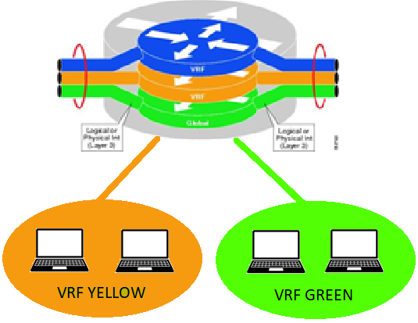

-Virtual Route Forwarding (VRF) is a technique which creates multiple virtual networks within a single network device.
-The purpose of VRFs is to isolate networks from one another.
-VRFs are assigned “names”
YELLOW Routing Table
GREEN Routing Table
-Each VRF has its own routing table
-Layer 3 Interfaces are assigned to VRFs and participate in that VRFs routing table.

Slide 3
VRF Overview
The normal routing table still exists…its commonly referred to as the “global” routing table
show ip route
show ip route vrf YELLOW
show ip route vrf GREEN
Global Routing Table
YELLOW Routing Table
GREEN Routing Table

Slide 4
VRF Configuration
ip vrf YELLOW
description YELLOW-NETWORK
!
ip vrf GREEN
!
interface Loopback 30
ip vrf forwarding YELLOW
ip address 192.168.1.1 255.255.255.255
!
interface Loopback 40
ip vrf forwarding GREEN
ip address 192.168.2.1 255.255.255.255
VRF Creation
(CASE Sensitive)
Optional description
VRF Creation
(CASE Sensitive)
Assign an interface to a VRF
Assign an interface to a VRF

Slide 5
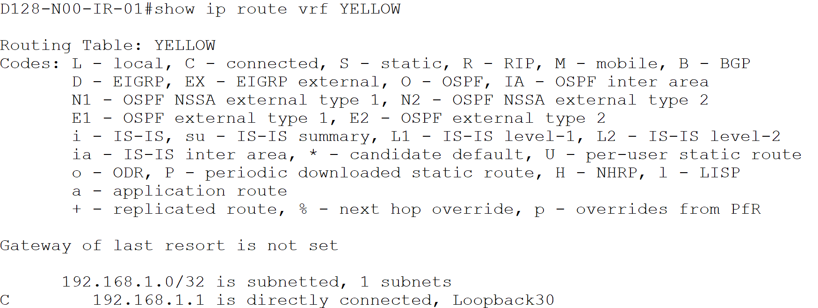
Validating VRF
Show vrf
Show ip route vrf YELLOW
*Only shows networks that are assigned to interfaces that are assigned to vrf YELLOW

Slide 6
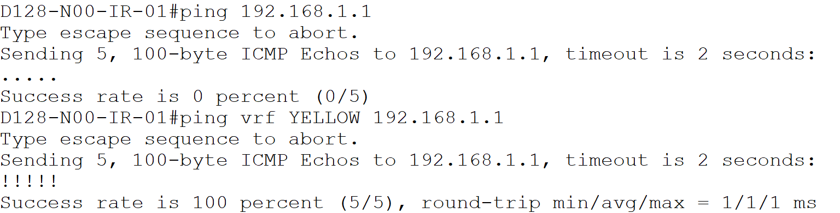
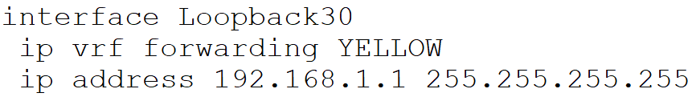
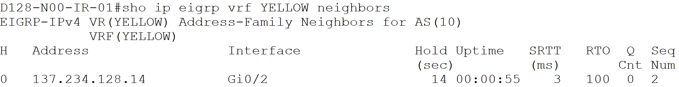
Validating VRF
Ping vrf <NAME> <IP-ADDRESS>
* In order to ping an IP/ Interface in a vrf, you must specify the vrf the IP/ Interface is a member of
Many commands related to vrfs add vrf <NAME> to the command

Slide 7
Troubleshooting VRF
Verify the interface is in the correct VRF with the show vrf command
Verify you are using the right command
show ip route vrf <NAME>
ping vrf <NAME> <IP-ADDRESS>
traceroute vrf <NAME> <IP-ADDRESS>
show ip rip database vrf <NAME>
***Not all commands follow the same format***
***Use “?” if you are having trouble finding the right vrf command***
Check the vrf’s routing table to verify you see the networks you expect to see:
show ip route vrf <NAME>
If networks are present that should not be part of that vrf a misconfiguration likely exists
It is recommended you do not reuse address space between vrfs
The router will let you do this…reusing addresses may confuse some administrators!
interface Loopback 30
ip vrf forwarding YELLOW
ip address 192.168.1.1 255.255.255.255
interface Loopback 40
ip vrf forwarding GREEN
ip address 192.168.1.1 255.255.255.255

Slide 8
QUESTION
Question:
True or false—VRFs are case sensitive
True or false—VRFs allow the same IP to be used in different VRFs?

Slide 9
VRF Lab DKET Transport
Write Erase/Reload
Reference DKET Transport Spoke Template and diagram.
Notes:
Use DKET template and have a site build the DKET Hub, use a Layer 3 switch running RIPv2 to connect all sites.

Slide 10
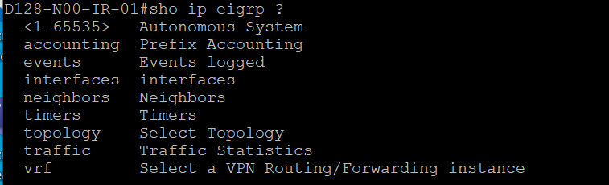
VRF Summary
VRFs allow the creation of isolated virtual networks within a single routing device.
Interfaces are assigned to VRFs and only participate within that VRFs routing table.
Viewing information about a VRF follows standard syntax but requires the VRF to be specified.
show ip route vrf <name>
Where the VRF is specificied may differ between commands. When in doubt use the “?” to locate where vrf specification goes.

